Slide 1


Education Dynamics Campaigns
On TopCollegeDegrees.net

Slide 2

By Clicking the “Online Schools” header, all of our online schools are listed, including Ashford University, Everest University, Post University, GCU, OCU, CTU and Capella University.
Headers

Slide 3
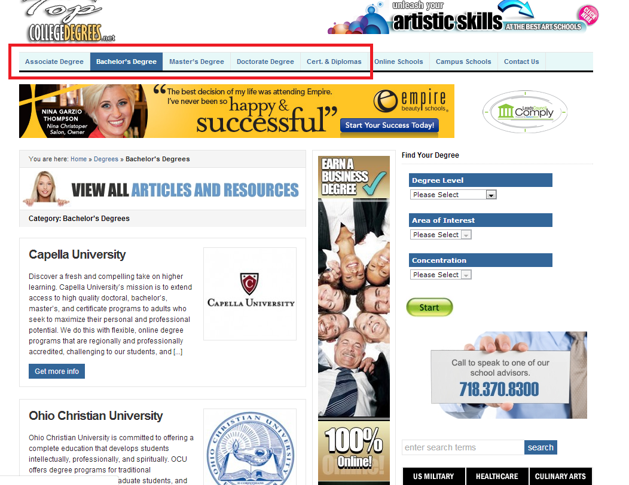
By clicking the Degree Types in the header, the corresponding schools display for the user to access the schools.
Headers

Slide 4

Featured Schools
Ashford is one of our featured schools and can be accessed by clicking the banner on our homepage. Once clicked, the user is taken to the school’s form.

Slide 5
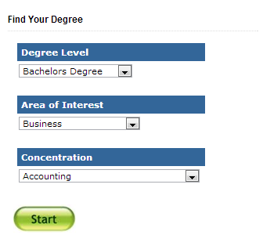
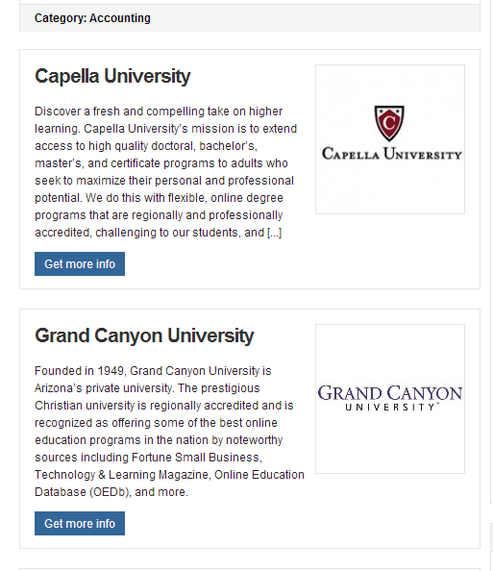
Search Widget
Our widget on the homepage allows the user to search by Degree Level, Area of Interest and Concentration. A list of corresponding schools display after the user clicks “Start”

Slide 6
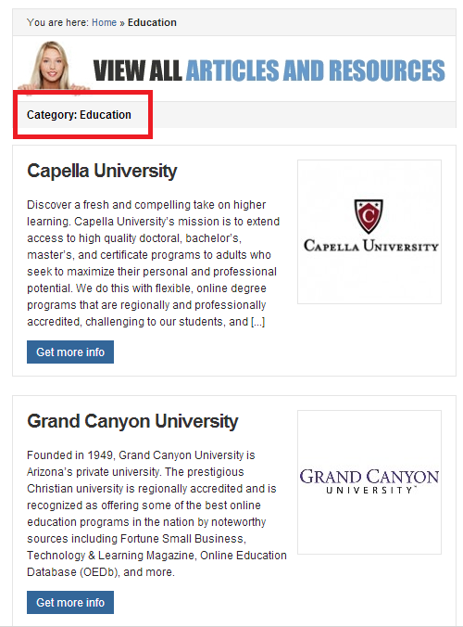

Search by Subject of Interest
The user can search by subject of interest, which is located on our homepage. The corresponding schools display once the category is selected.

Slide 7



Banners
TCD has banners that direct the user in 2 ways. A Category banner, such as US Military, Healthcare or Culinary Arts, directs the user to a list of corresponding schools. A School Banner, such as GCU below, directs the user to the school form.

Slide 8

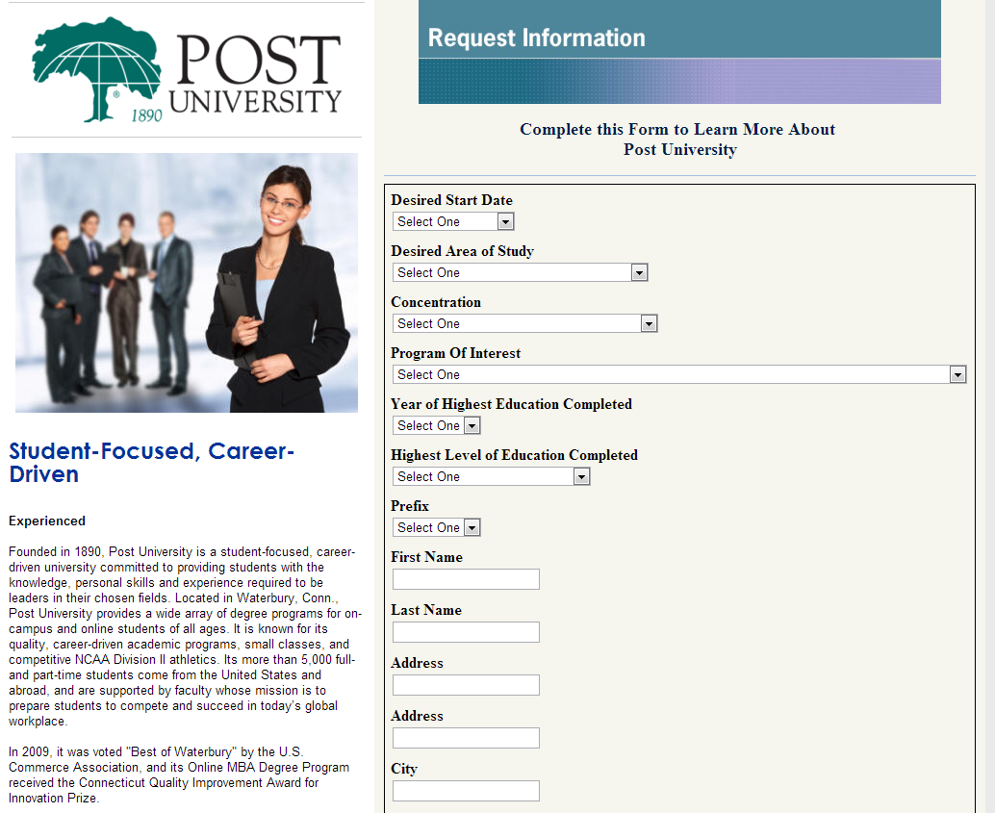
Get More Info
Once the user selects the “Get More Info” button, the school’s form will display.

Slide 9
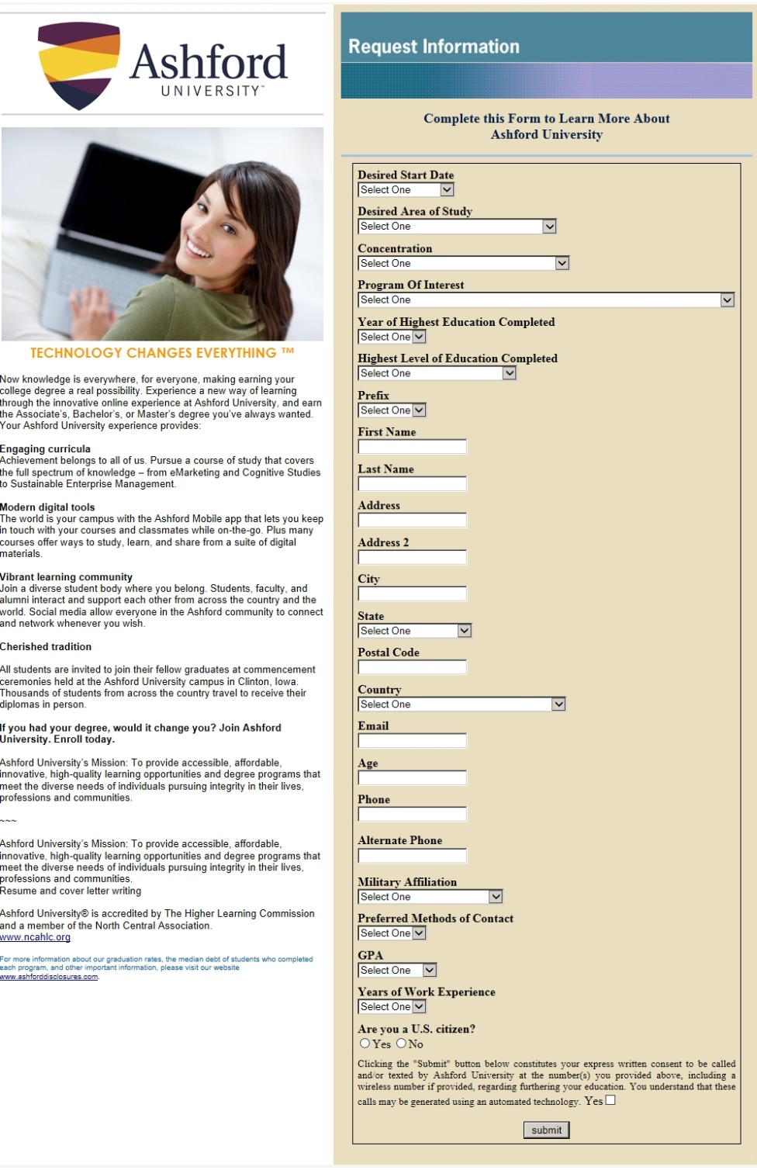
Ashford University

Slide 10
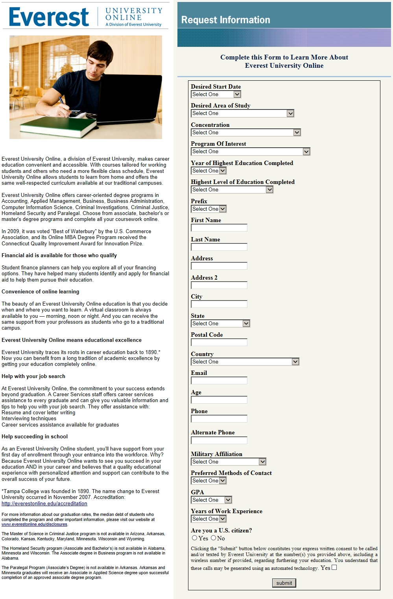
Everest University

Slide 11
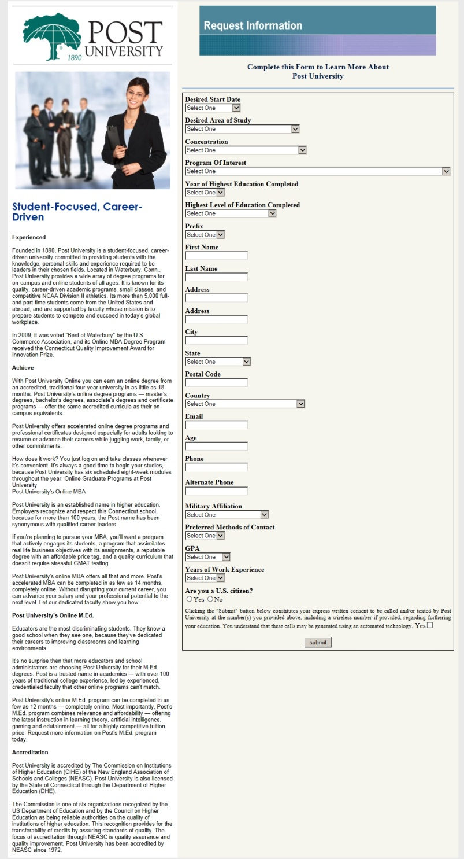
Post University

Slide 12
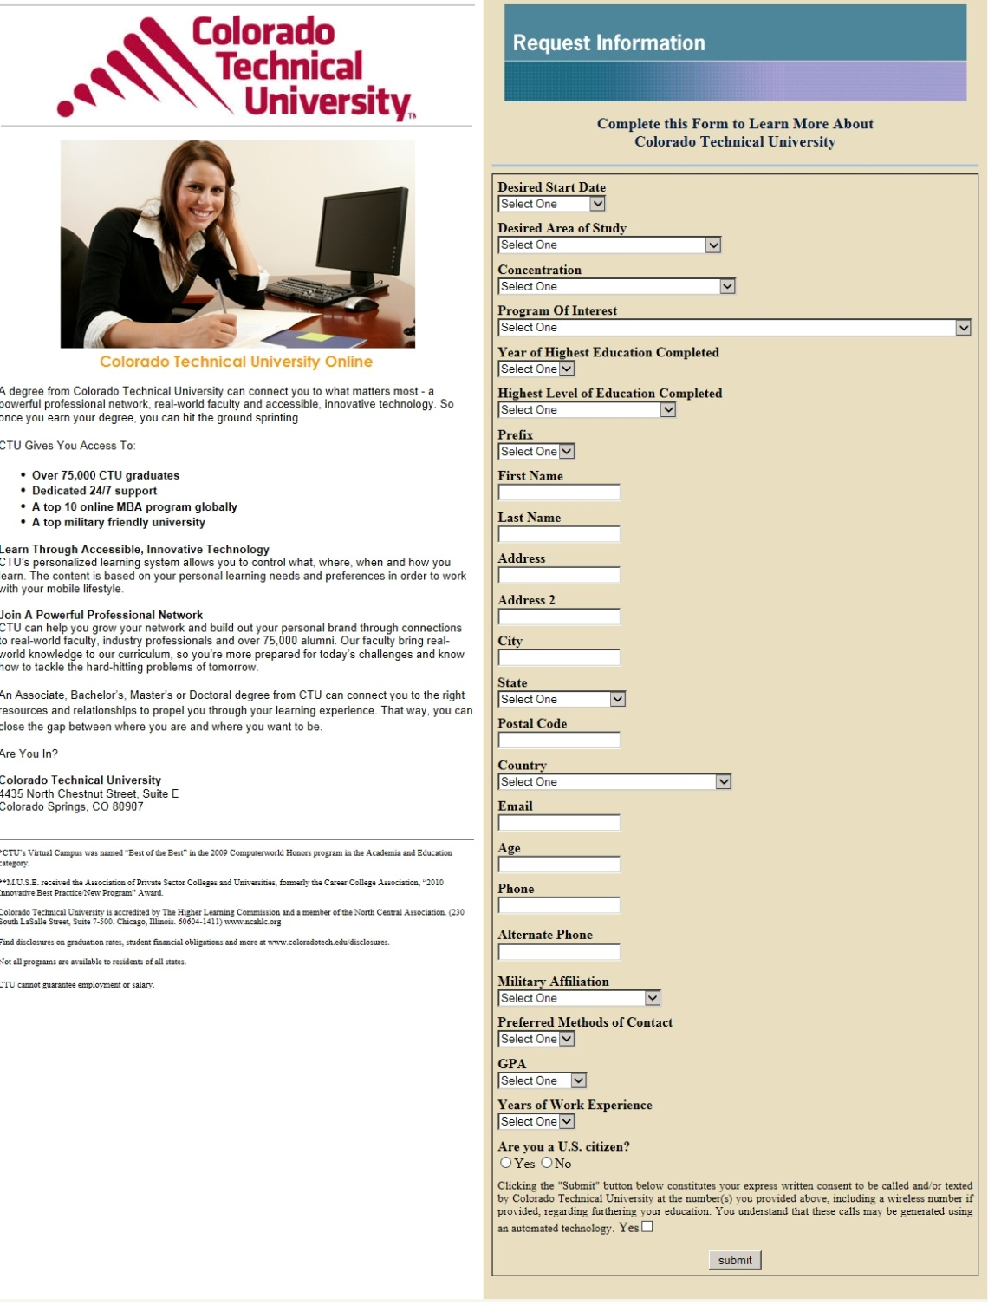
Colorado Technical University

Slide 13
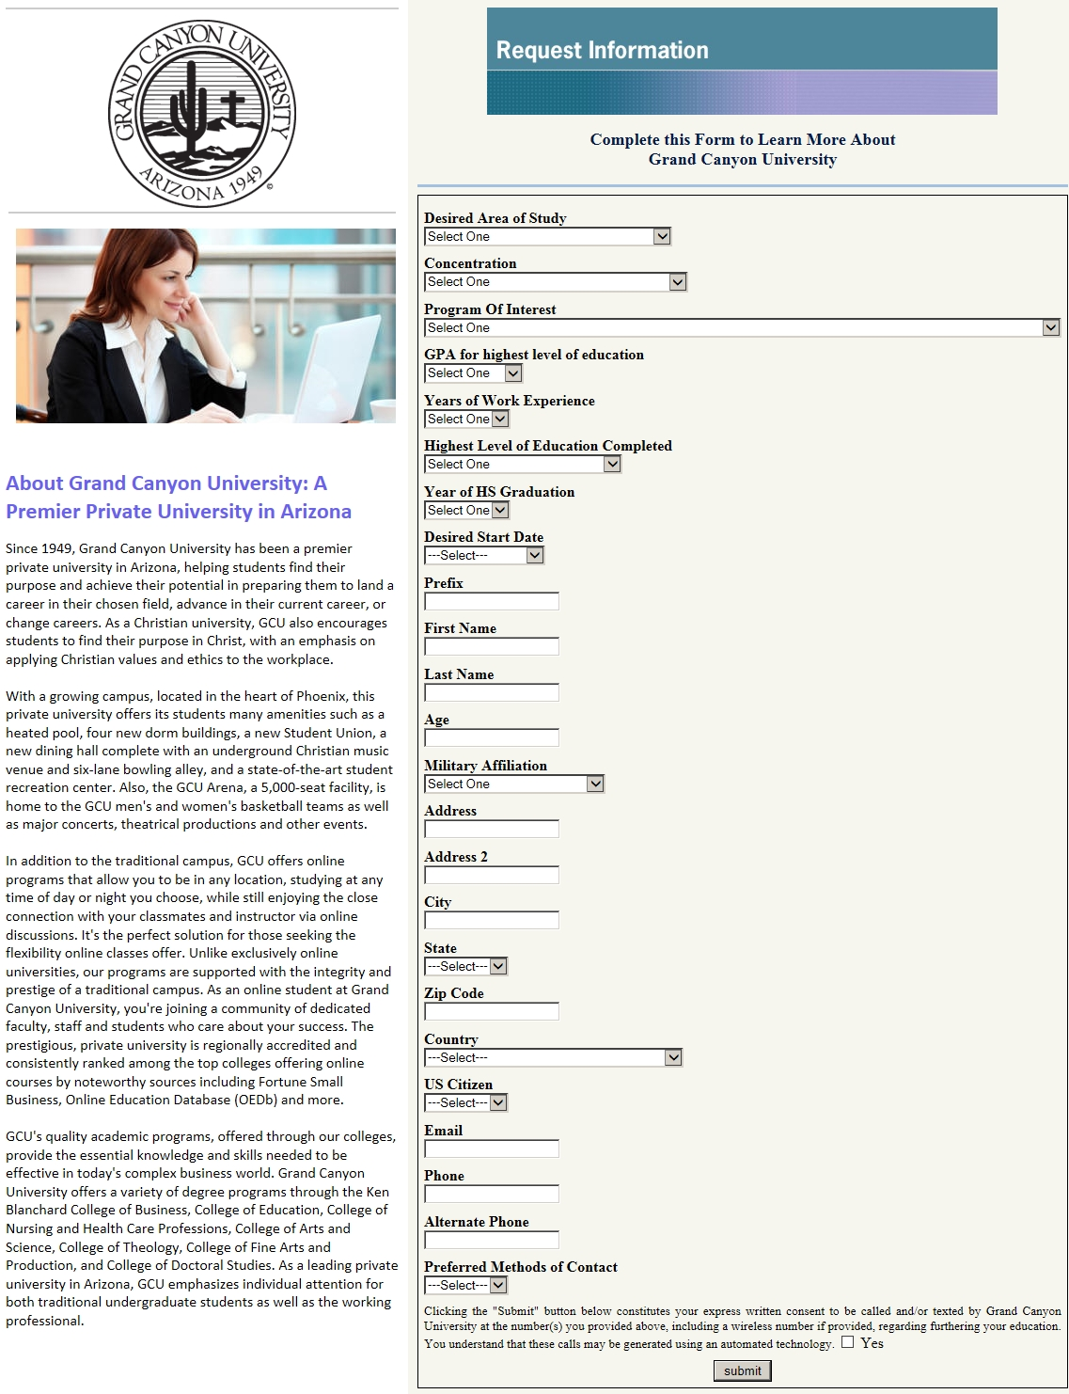
Grand Canyon University

Slide 14
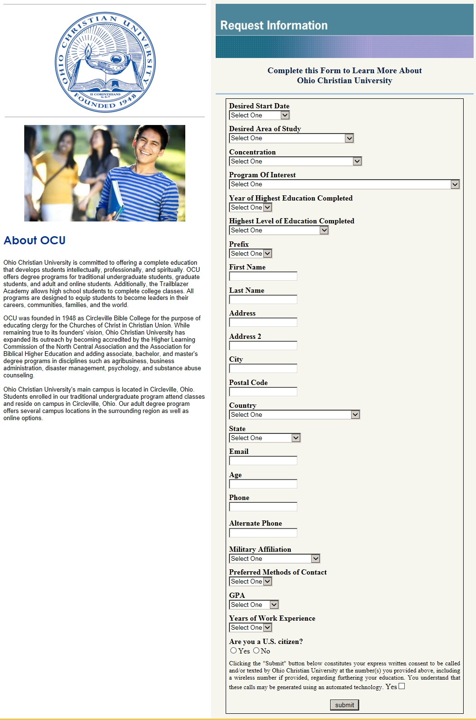
Ohio Christian University

Slide 15
Rising Results, Inc
Contact Info:
718-370-8300

