Slide 1


Slide 2

Introducing
Rising Results – a performance-based online media company run by industry veterans. Providing a platform for deploying multiple online lead generation campaigns across any number of publisher sites.
Company founded in 2001
Works with leading Retail , CPG , Travel and Entertainment Brands
Exclusive publisher network of over 65 million consumers, ability to target by lifestyle, age, interest, geography and other key data to only server offers to relevant audiences
Acquires high lifetime-value consumers on a cost-effective CPL basis
Hosted Lead Generation or CPA Display Media driven to client hosted websites

Slide 3
Our Promise
Full publisher transparency: know exactly where your program will run since we deliver a fully transparent media plan based on your specific needs.
Stringent data validation/management: our customized technology solutions can collect, validate, de-dupe, and pass your data in one clean uniquely coded file. We can also deploy multiple Auto Responder emails with dedicated IP addresses to protect your brand's reputation with ISP's.
Optimization by individual publisher source: utilize actionable intelligence to continually optimize your campaign by publisher, cost and creative – maximizing your ROI.
Total campaign control: knowing where your brand will appear, combined with the ability to direct the media plan placements, cost, volume and results assures you're always in control.
Targeting: Display Media, ability to target by age, income, lifestyle, presence of children and HHI

Slide 4














Connect with publishers reaching Health, Finance, Education, Retail and more…such as:

Slide 5
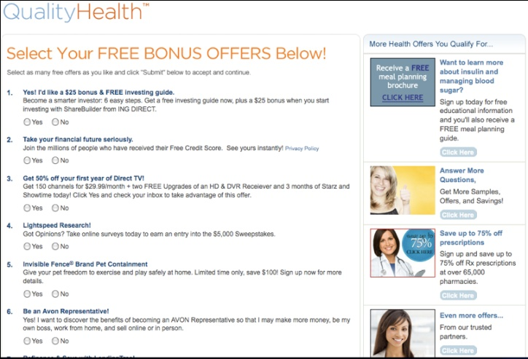



CPL Solutions At Work
1
Consumers
arrive on publisher registration pages
2
Consumers are presented with branded promotions in various formats where they can proactively select offers of interest during user registration
Mock-ups are for demonstrational purposes only.

Slide 6
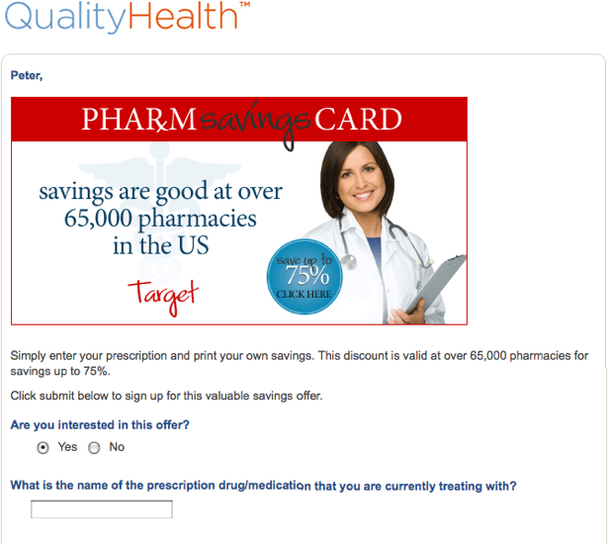
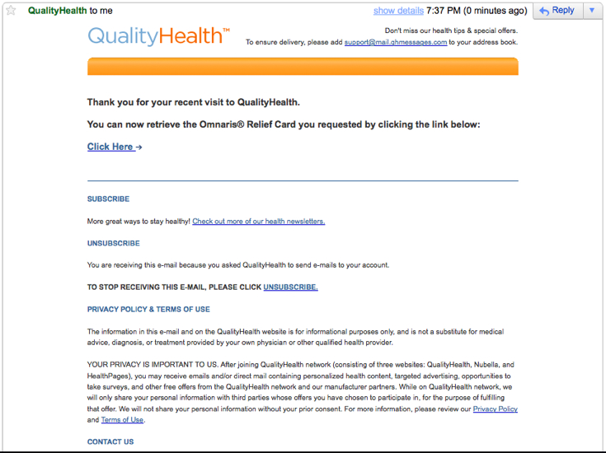

CPL Solutions At Work
3
4
Selected offers are confirmed and auto responder email(s) can be deployed if needed.
Upon viewing the offers, consumers complete all required offer information
& re-confirm
their selection, allowing their personal information to be sent to the desired brand via RR.
Mock-ups are for demonstrational purposes only.

Slide 7
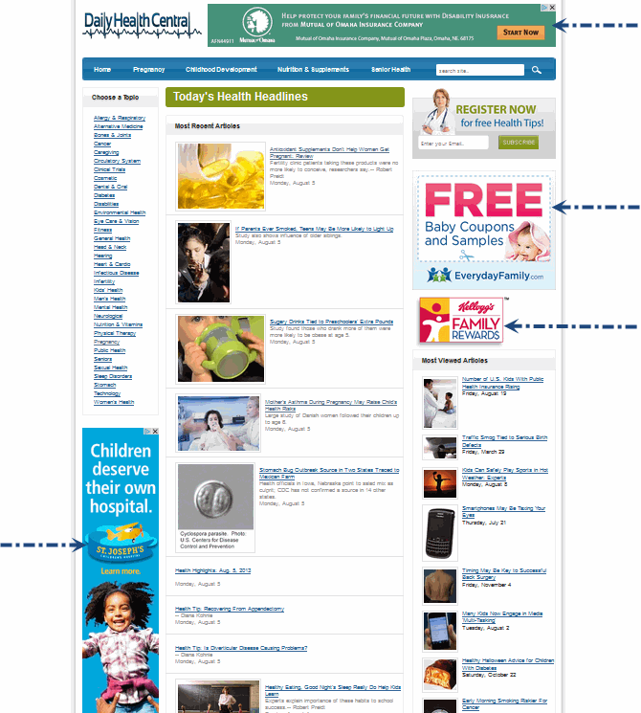
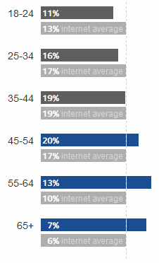

Display and Email Capabilities
Media Available on CPA or CPM
Reach of 65 million consumers monthly
71% Female Audience, 39% Age 35-54

Slide 8
SUMMARY
Performance-Based Solution
Pay on a fixed cost per lead basis for people who have opted-in and actively signed up and asked to communicate with your brand. Display media on CPL, CPA or CPM
100% Transparent
Always know where your brand and offers are running
Superior Validation
Our platform provides sophisticated email validation to collect, filter, de-dupe, area code/exchange validation, DPV level postal validation and flexible delivery formats
Total Management Control
A simple platform that allows you to manage, optimize and control multiple campaign placements on any number of relevant sites
Industry Veterans
RR is operated by hands-on, senior level personnel with years of industry experience and contacts who work primarily via exclusive relationships to maximize program potential

Slide 9





Contact
Paul Cetrola
President and Ceo
Rising Results, Inc.
718-370-8301
paul@risingresults.com
Some Clients we work with:

